Slide 1
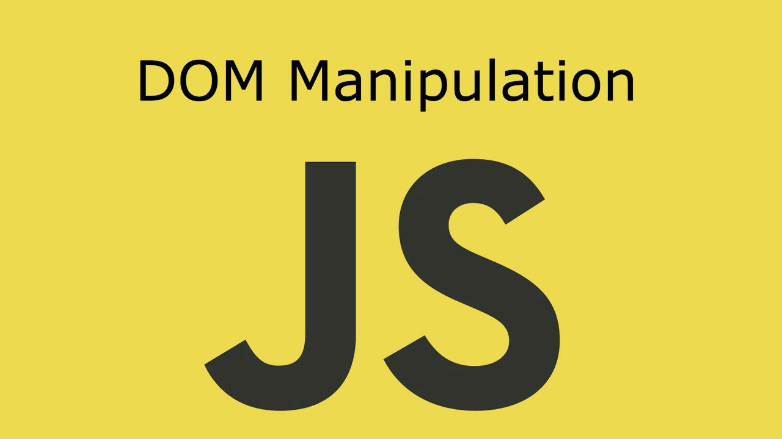
DOM Manipulations
Create / Delete DOM Elements, Handle Browser Events
SoftUni Team
Technical Trainers
Software University
http://softuni.bg

Slide 2
Table of Contents
Manipulating the DOM
Create Elements
Delete Elements
jQuery Methods
Event Handling
Attach / Detach Events

Slide 3
Have a Question?
sli.do #JS-CORE

Slide 4


DOM Manipulations
Create / Delete DOM Elements

Slide 5
Creating DOM Elements
Create with document.creatеElement
Append text to the <p> element
Text added to textContent will be escaped.
Text added to innerHTML will be parsed and turned into actual HTML elements beware of XSS attacks!
let p = document.createElement("p");
let text = document.createTextNode("Random Text");
p.appendChild(text);

Slide 6
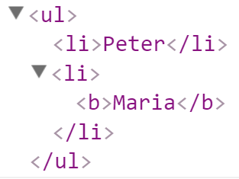
Creating DOM Elements
let list = document.createElement("ul");
let liPeter = document.createElement("li");
liPeter.textContent = "Peter";
list.appendChild(liPeter);
let liMaria = document.createElement("li");
liMaria.innerHTML = "<b>Maria</b>";
list.appendChild(liMaria);
document.body.appendChild(list);

Slide 7
Deleting DOM Elements
To remove an HTML element, you must know the his parent
<div id="div1">
<p id="p1">This is a paragraph.</p>
<p id="p2">This is another paragraph.</p>
</div>
let parent = document.getElementById("div1");
let child = document.getElementById("p1");
parent.removeChild(child);

Slide 8

jQuery and DOM
Using jQuery to manipulate DOM

Slide 9
jQuery Methods
text() - reads and writes text
html() - returns the HTML of a given element
val() - gets and sets value
let text = $('#theElement').text();
$('#theElement').text('New text for element.');
let html = $('#theElement').html();
$('#theElement').html('New text for element.');
let theValue = $('#theFormField').val();
$('#theFormField').val('New value');

Slide 10
jQuery Methods
attr() - reads and writes attributes of HTML elements. Also can take a object as parameter
removeAttr() - removes an attribute from an HTML element
wrap() - wraps the selected element in another HTML element
let attrValue = $('#theFormField').attr('height');
$('#theFormField').attr({height : attrValue});
$('#theFormField').removeAttr('height');
$('#someElement').wrap('<div style="border: 1px solid black;"></div>');

Slide 11
jQuery Methods
replaceWith() - replaces the selected HTML element with a new one
remove() - removes the selected HTML element from the DOM
empty() - removes all child elements of the selected HTML element
$('#theElement').replaceWith('<div style="border: 1px solid black;"></div>');
$('#theElement').remove();
$('#theElement').empty();

Slide 12



event
Handling Events
Browser Events and DOM Events

Slide 13
Handling Events in JS
Browsers send events to notify the JS code of interesting things that have taken place
<div id='text'>Some text</div>
let div = document.getElementById('text');
div.onmouseover = function(event) {
event.target.style.border = "3px solid green";
}
div.onmouseout = function() {
this.style.border = ""; // this === event.target
}

Slide 14
Event Types in DOM API
Mouse events
Touch events
DOM / UI events
click
mouseover mouseout mousedown
mouseup
touchstart
touchend
touchmove
touchcancel
load
unload
resize
dragstart / drop
Keyboard events
Focus events
Form events
keydown
Keypress
keyup
input
change
submit
reset
focus (got focus)
blur (lost focus)

Slide 15
Attach / Remove Events
Attach an event to an element.
Remove an event.
let textbox = document.createElement('input');
textbox.type = 'text';
textbox.value = "I am a text box";
document.body.appendChild(textbox);
textbox.addEventListener('focus', focusHandler);
function focusHandler(event) {
textbox.value = "Event handler removed";
textbox.removeEventListener('focus', focusHandler);
}

Slide 16
Multiple Events
The addEventListener() method also allows you to add many events to the same element, without overwriting existing events:
Note that you don't use the "on" prefix for the event; use "click" instead of "onclick".
element.addEventListener("click", function);
element.addEventListener("click", myFunction);
element.addEventListener("mouseover", mySecondFunction);
element.addEventListener("mouseout", myThirdFunction);

Slide 17
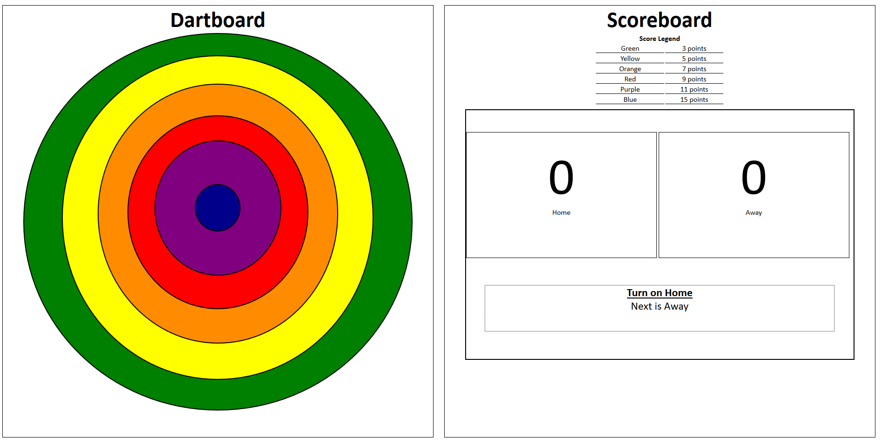
Exam problem: Dart Game
Write a JavaScript program that simulates playing a Dart and keep tracking the players scores
Use the given index.html and app.js files to solve this problem
Check your solution here: https://judge.softuni.bg/Contests/1390/JS-Advanced-Exam-19-December-2018

Slide 18

Live Exercises
DOM - Manipulations

Slide 19
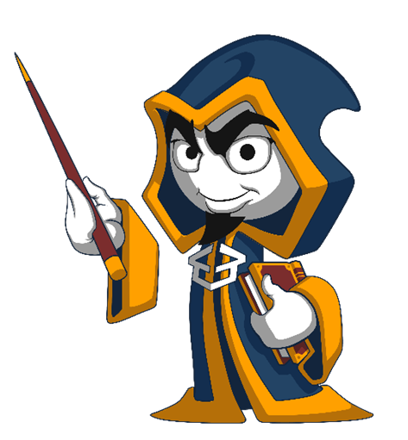
Summary
Arrow functions ≈ short function syntax
Modifying DOM elements:
Handling events:
let menu = document.getElementById('menu');
menu.style.display = 'none';
menu.appendChild(
document.createElement('hr'));
let link = menu.children[0];
menu.removeChild(link);
let menu = document.getElementById('menu');
menu.onclick = function(event) { … }

Slide 20
//TODO

Slide 21













SoftUni Diamond Partners

Slide 22





SoftUni Organizational Partners

Slide 23




Trainings @ Software University (SoftUni)
Software University – High-Quality Education and Employment Opportunities
softuni.bg
Software University Foundation
http://softuni.foundation/
Software University @ Facebook
facebook.com/SoftwareUniversity
Software University Forums
forum.softuni.bg

Slide 24

License
This course (slides, examples, demos, videos, homework, etc.) is licensed under the "Creative Commons Attribution-NonCommercial-ShareAlike 4.0 International" license

